Slide 1
Using ADC in atmega32
CSE 315
Md. Iftekharul Islam Sakib

Slide 2
Learning objective
Why do we need ADC?
What is ADC?
ADC in ATmega32
A simple example

Slide 3
Recap
MCU is a digital processor
Works with binary data
Just 2 voltage levels
MCU needs to collect information from the real world
Temperature, Pressure, Humidity, Sound …
Continuous property
Infinite possible values
Why do we collect information?
To analyze the situation
To take appropriate actions

Slide 4
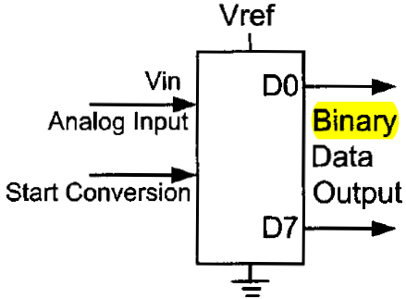
ReCAP
But how to collect information?
Sensors: Convert physical property into analog signal
Voltage, Current, Resistance, …
How can MCU recognize these signal?
Need to convert into digital data
How?
Approximation
Need something special!

Slide 5
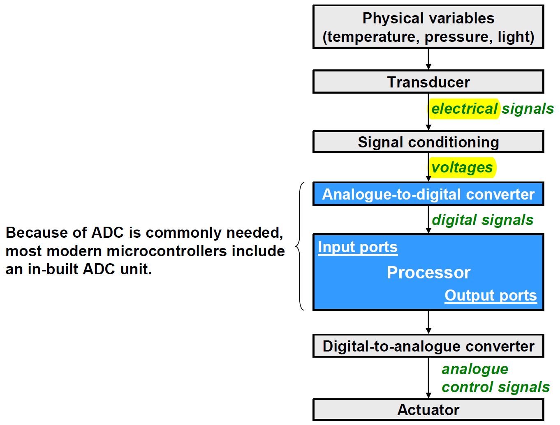
Typical embedded application

Slide 6
ADC: Quick review

Slide 7
A-to-D conversion
Two related steps
Sampling (Approximating the X-axis)
the analogue signal is extracted at regularly spaced time instants
the samples have real values
Quantization (Approximating the Y-axis)
the samples are quantized to discrete levels
each sample is represented as a binary value

Slide 8
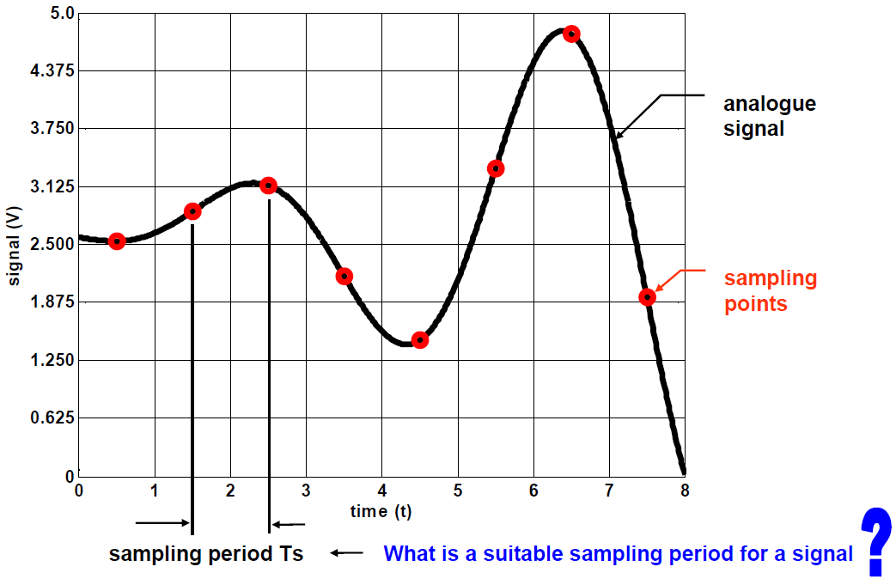
Sampling an analogue signal

Slide 9
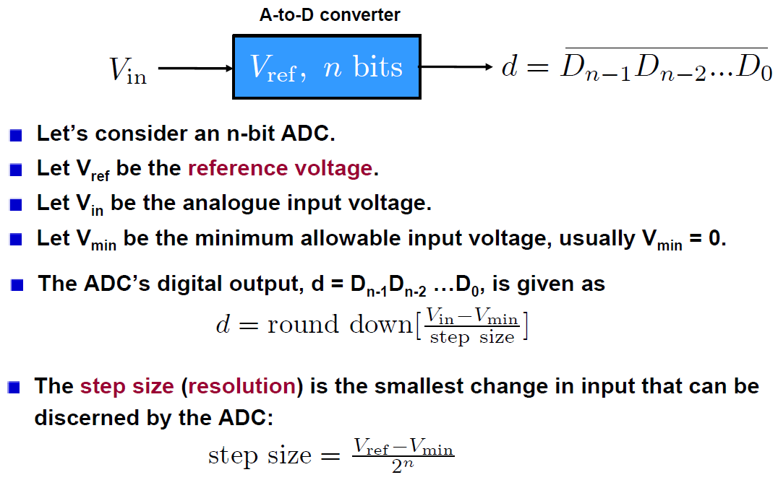
Quantizing the sampled signal

Slide 10
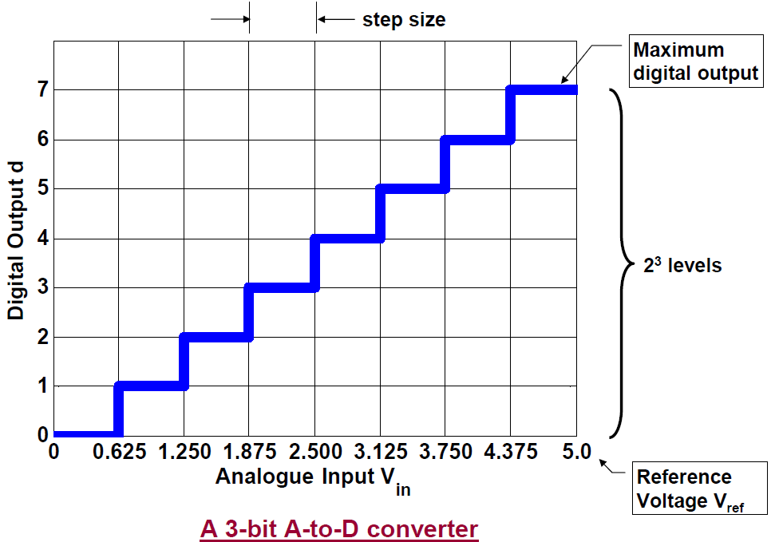
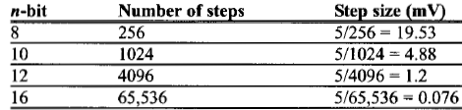
Quantizing the sampled signal

Slide 11
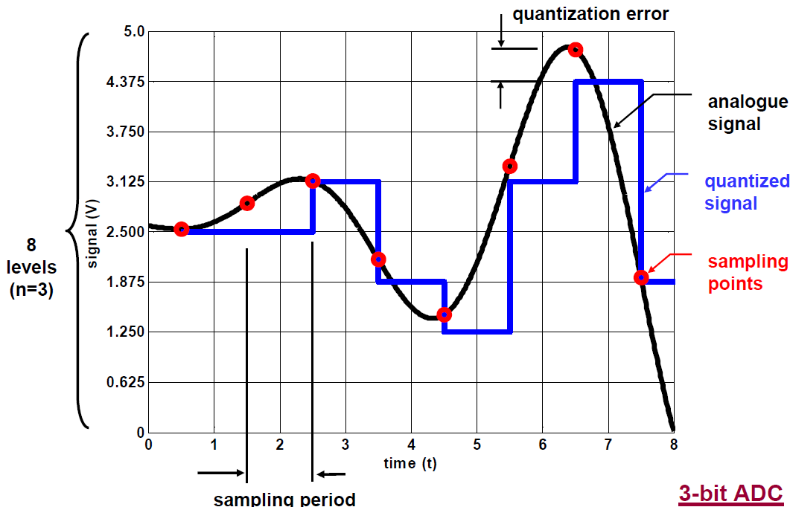
Quantizing the sampled signal

Slide 12
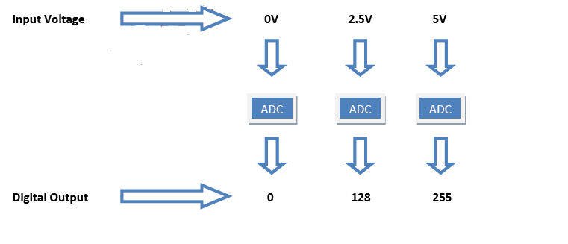
8-bit adc

Slide 13
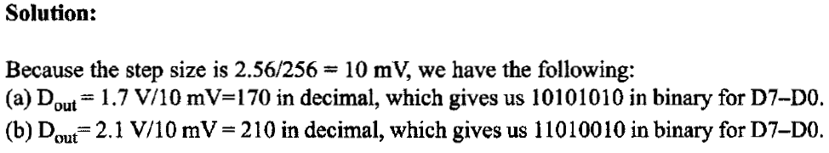
example

Slide 14
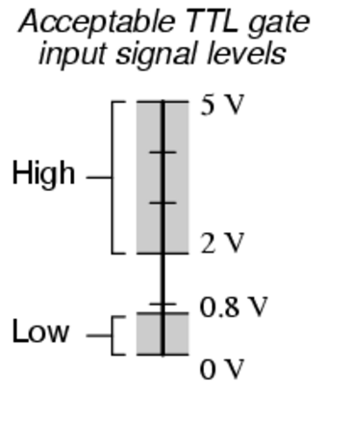
A question
What is the difference between an ADC and a digital input pin?

Slide 15
The ADC in ATmega32
The ADC has a 10-bit resolution.
The binary output has n = 10 bits
The ADC has 8 input channels
Analogue input can come from 8 different sources
However, it performs conversion on only one channel at a time
If default reference voltage V_{ref} = 5V is used
step size: 5 V/1024 = 4.88mV
The clock rate of the ADC can be different from the CPU clock rate
One ADC conversion takes 13 ADC cycles
An ADC prescaler will decide the ADC clock rate

Slide 16
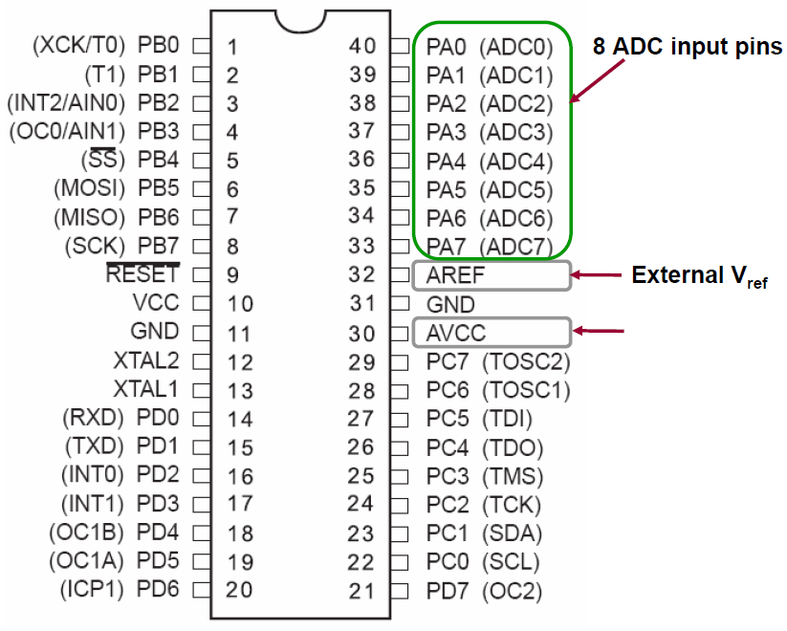
Relevant pins

Slide 17
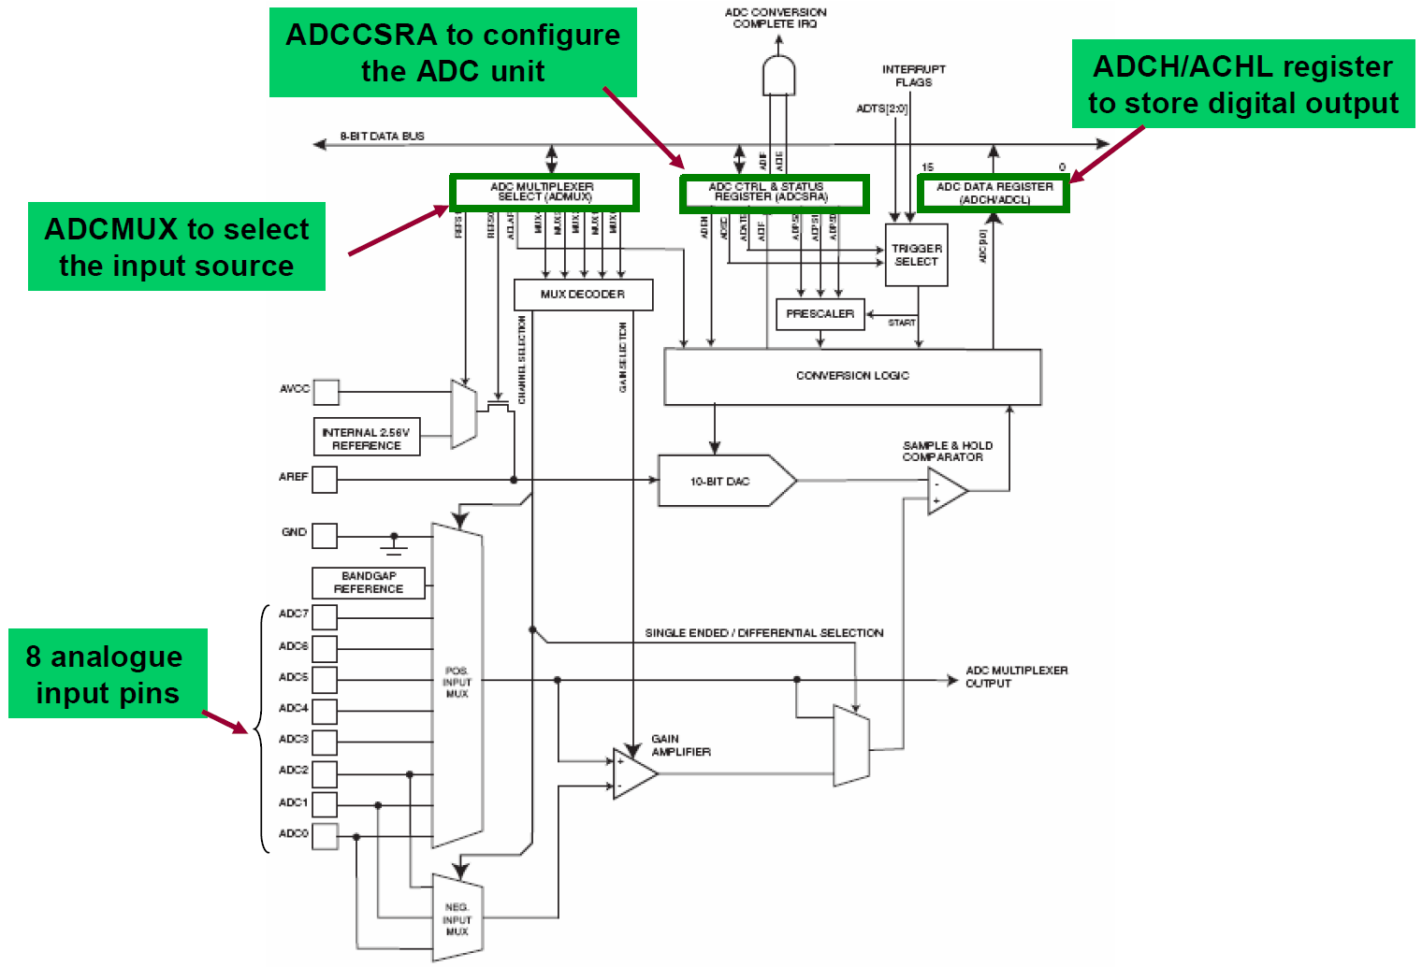
Block diagram

Slide 18
Main aspects
What are the relevant ADC registers?
ADCMUX
ADCH/ADCL
ADCCSRA
SFIOR
What are the steps to use the ADC?
How to use ADC interrupt?

Slide 19
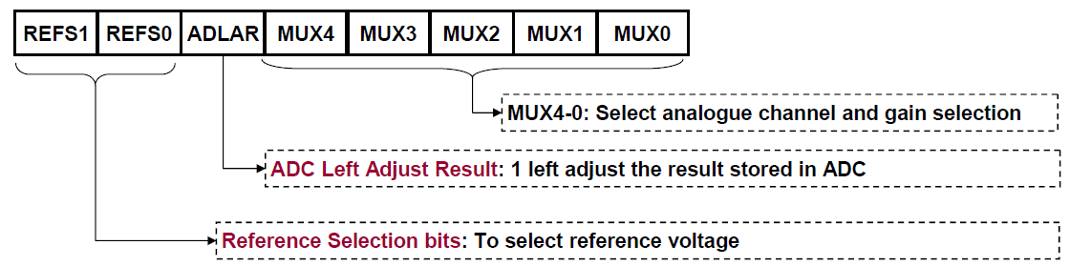
ADC Multiplexer Selection Register (ADCMUX)

Slide 20
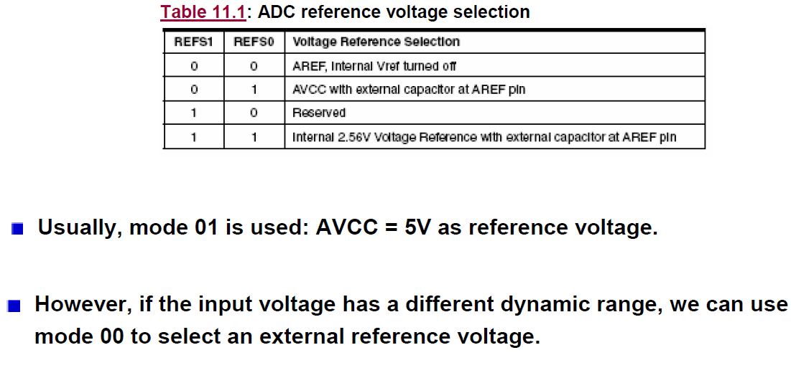
Selecting reference voltage V_{ref}

Slide 21
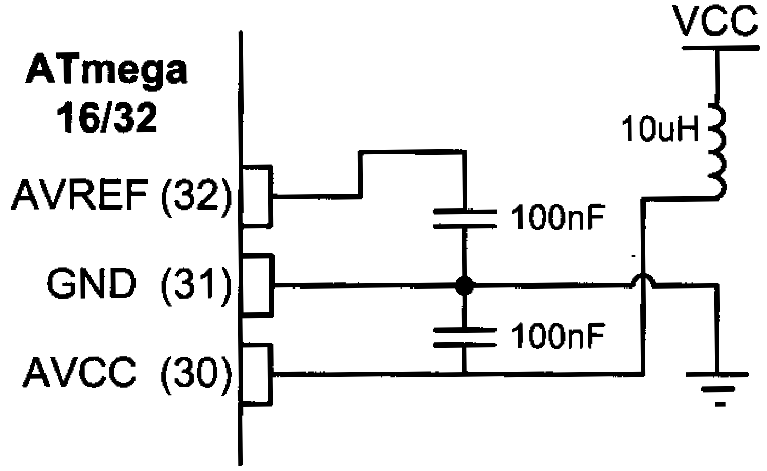
ADC Recommended connection

Slide 22
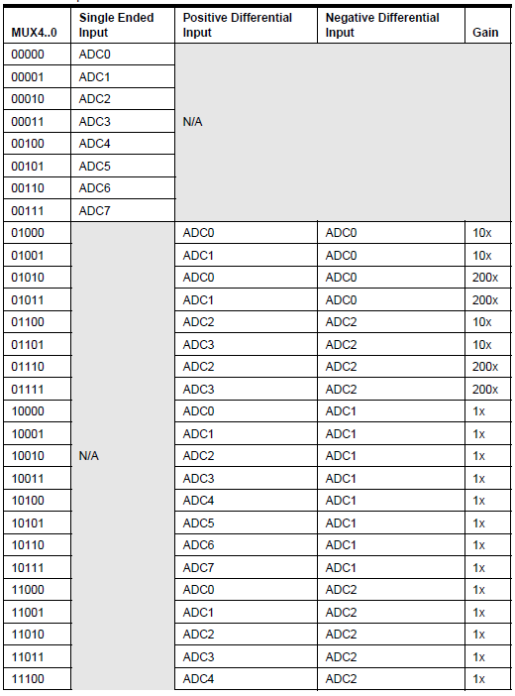
Selecting input source

Slide 23
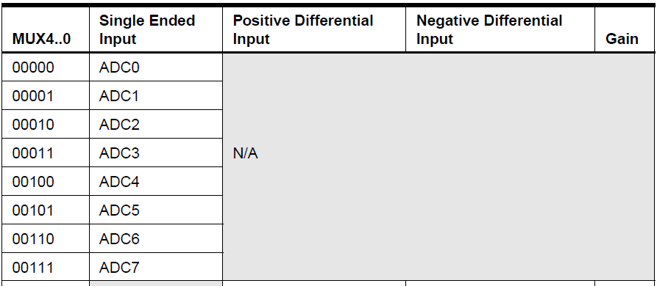
Selecting input source

Slide 24
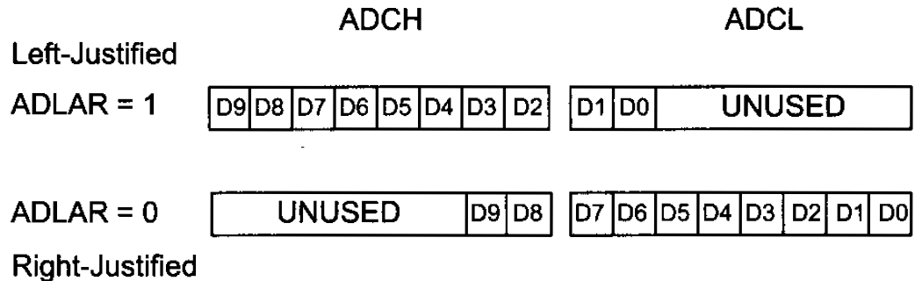
ADCH & ADCL registers
Important
When retrieving digital output, register ADCL must be read first, before register ADCH.

Slide 25
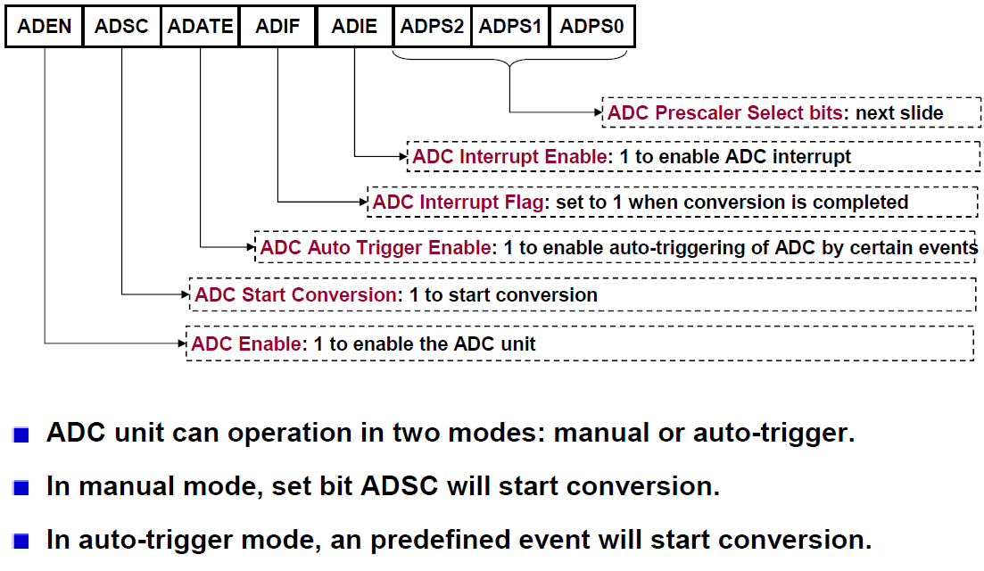
ADC Control and Status Register (ADCCSRA)

Slide 26
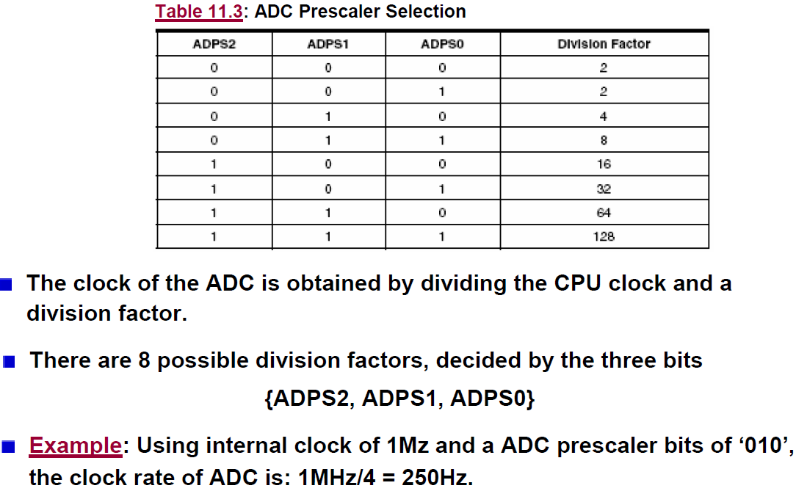
ADC clock

Slide 27
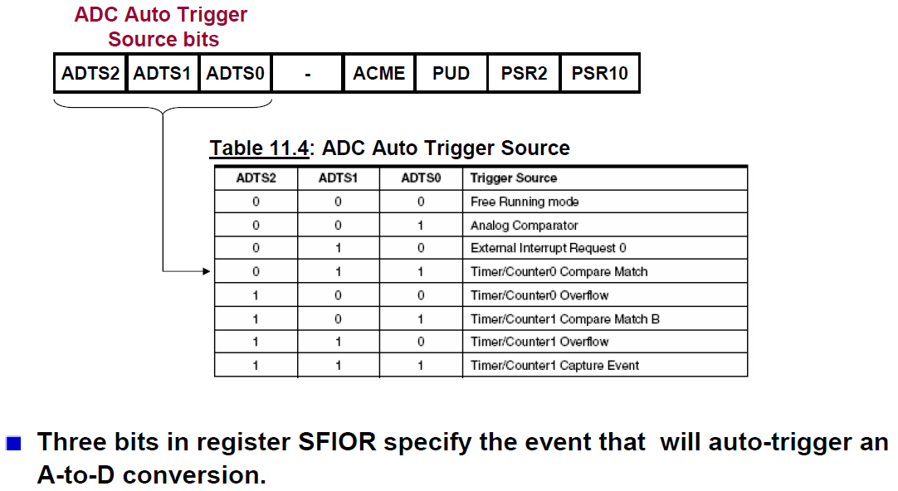
Special Function IO Register (SFIOR)

Slide 28
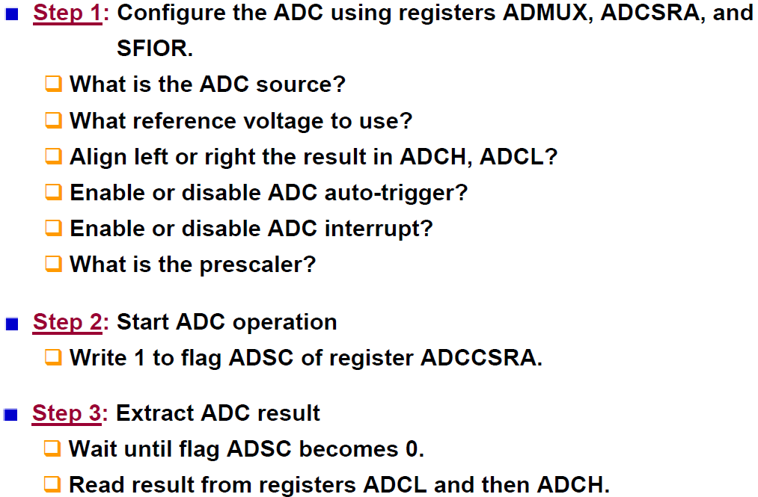
Steps to use the ADC

Slide 29
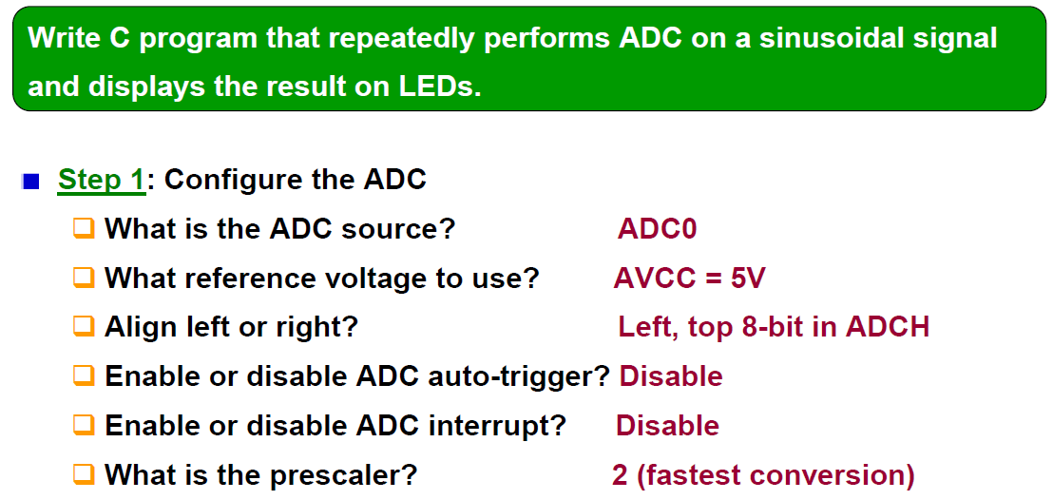
Simple Example

Slide 30
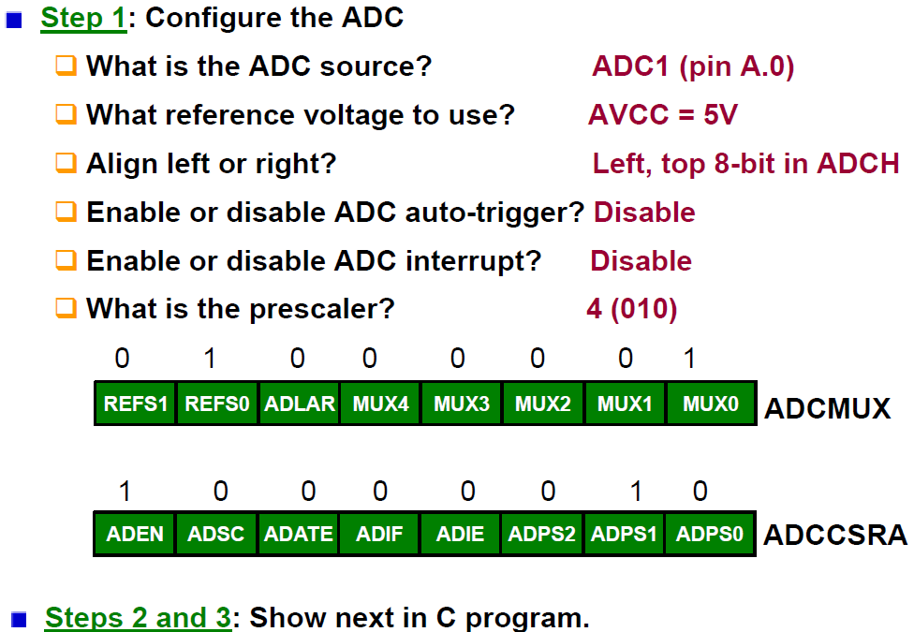
Simple Example

Slide 31
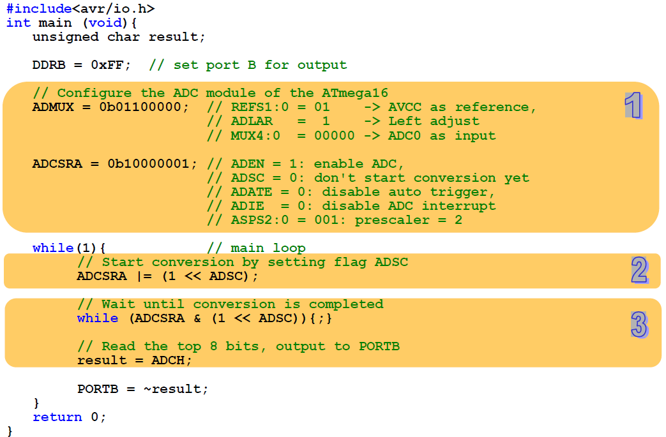

Slide 32
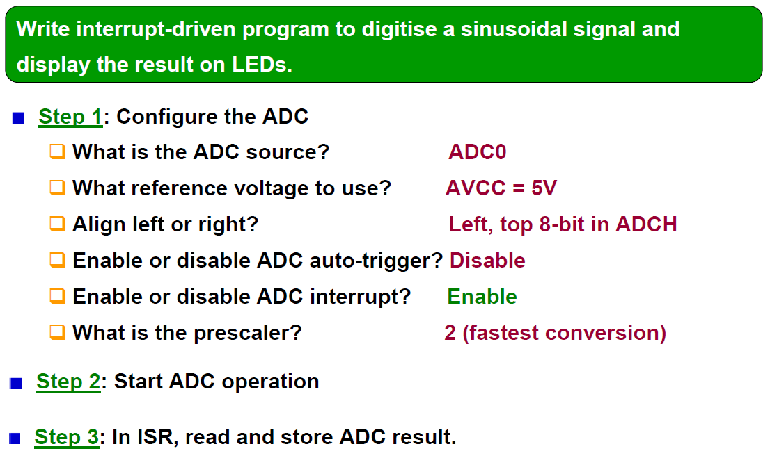
Simple Example: Using ADC interrupt

Slide 33
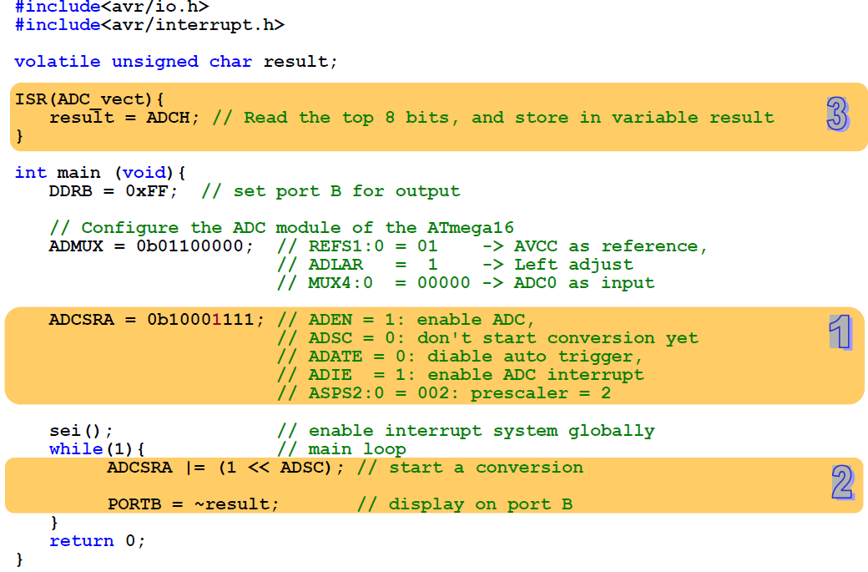

Slide 34
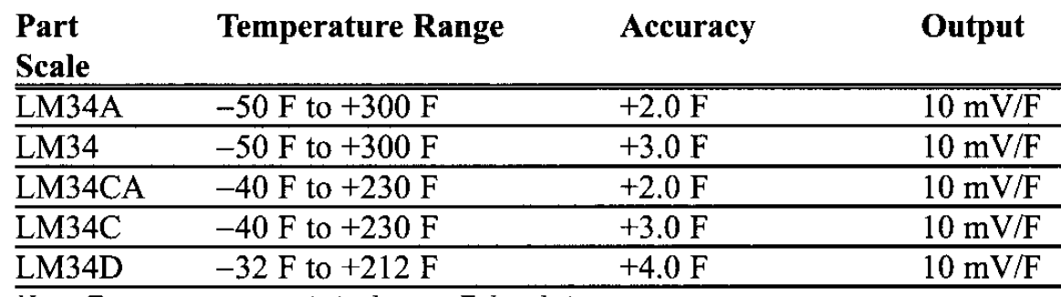
Temperature sensor

Slide 35
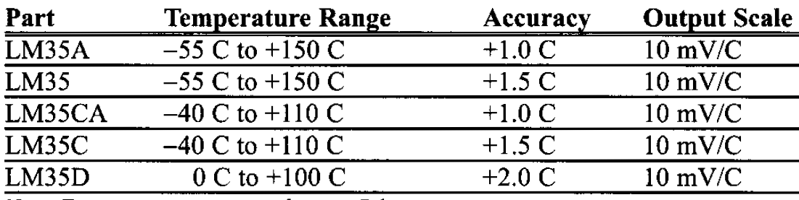
Temperature sensor

Slide 36
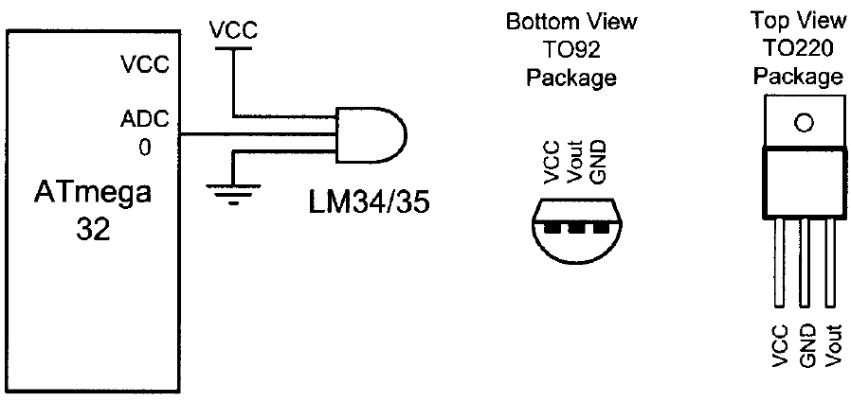
Interfacing LM34 to AVR

Slide 37
Interfacing LM34 to AVR
If we use the internal 2.56 V reference voltage
step size would be 2.56 V/1024 = 2.5 mV
This makes the binary output of the ADC four times the real temperature
Divide the binary output by 4 to get the real temperature

Slide 38
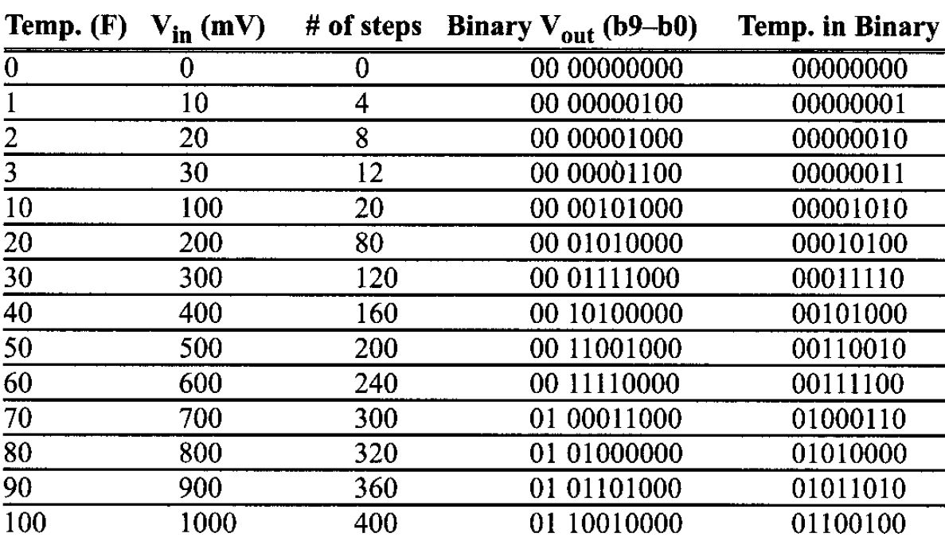
Interfacing LM34 to AVR

Slide 39
Interfacing LM34 to AVR
#include <avr/io.h> //standard AVR header
int main (void)
{
DDRB = 0xFF; //make Port B an output
ADCSRA = 0x87; //make ADC enable and select ck/128
ADMUX = 0xE0; //2.56 V V_{ref} and ADCO single-ended
//data will be left-justified
while (1 ){
ADCSRA |= (l<<ADSC); //start conversion
while((ADCSRA & (l<<ADIF))==0); //wait for end of conversion
PORTB = ADCH; //give the high byte to PORTB
}
return 0;
}

Slide 40
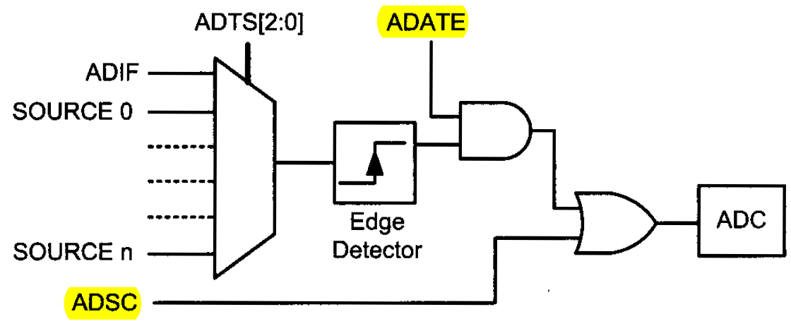
Auto trigger logic

Slide 41
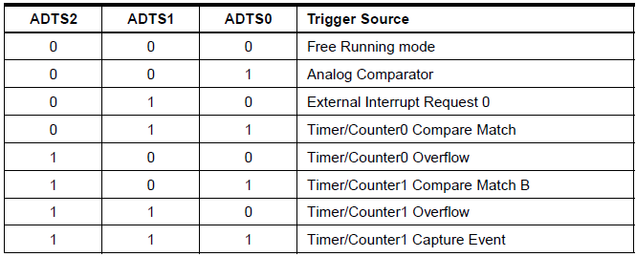
Auto Trigger Source

Slide 42
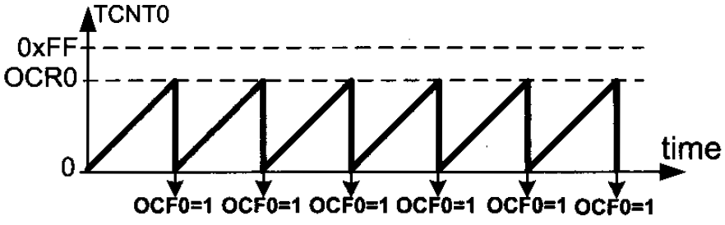
Timer: Normal vs. CTC mode

Slide 43
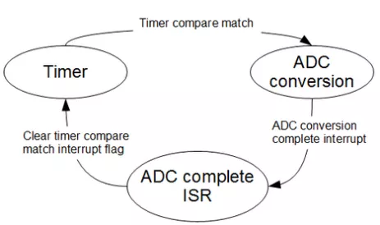
A practical problem
We need to sample an analog signal @ 20 kHz sampling frequency
The only way to do this correctly
use auto-triggering with exact time intervals
Let’s see how can we do this using Timer0

Slide 44
Solution Overview
Assume
system clock frequency = 16 MHz
Timer0 prescaler = 8
To ensure 20 kHz sampling frequency
Time between successive ADC conversions?
50us
Use Timer0 to trigger ADC every 50us
How to trigger Timer0 compare match every 50us?
Need to count?
50us/(8/16000000) = 100
From 0 to 99
Set OCR0 = 99

Slide 45
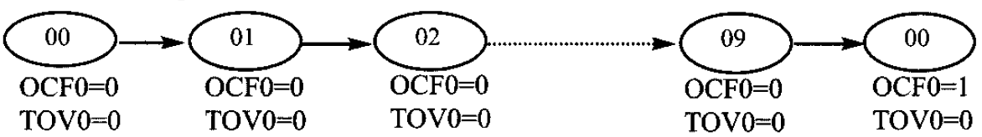
Solution Overview
Timer0 compare match trigger every 50us
Need to count?
50us/(8/16000000) = 100
From 0 to 99
Set OCR0 = 99
Why 99 instead of 100 ?

Slide 46
Solution Overview
Now let’s select ADC prescaler properly
ADC conversion must be completed before next Timer0 compare match occur
One auto triggered ADC conversion time takes 13.5 ADC cycles

Slide 47
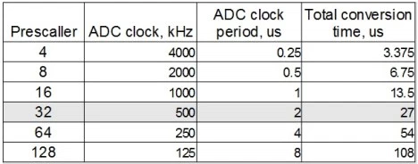
Solution Overview
Now let’s select ADC prescaler properly
ADC conversion must be completed before next Timer0 compare match occur
One auto triggered ADC conversion time takes 13.5 ADC cycles

Slide 48
Solution Overview
To fit in to 50us window we can select prescaller up to 32
Gives enough time to
Complete auto triggered ADC cycle
Clear Timer0 compare match flag
Store ADC value within one sample period
…

Slide 49
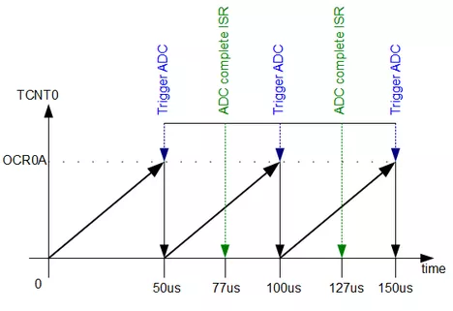
Solution Overview
ADC prescaller = 32
Gives enough time to
Complete auto triggered ADC cycle
Clear Timer0 compare match flag
Store ADC value within one sample period
…

Slide 50
Complete code for Atmega328
http://www.embedds.com/adc-on-atmega328-part-2/

